Slide 1
AIIP Innovation and Intrapreurship
Seloke Fabiao
2018-08-24

Slide 2
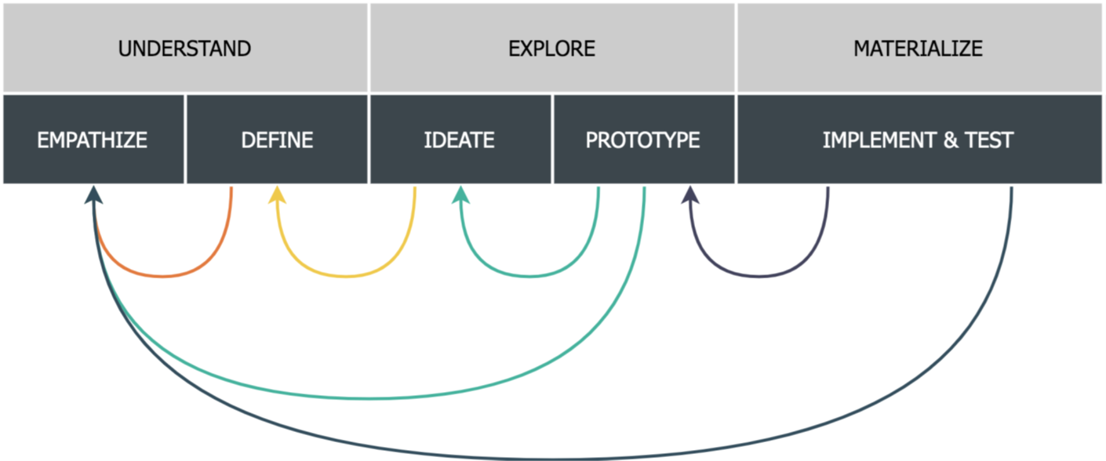
Overview
Problem statement
Transnet Freight Rail, Technology Management have had security breaches in the recent past which is effecting employee safety and mental well being. A solution to address this security concern is of great importance.
Design thinking approach overview
Design thinking application

Slide 3
Design thinking application - Understanding the problem (Empathize and Define)
Interviews
Interview Questions
How long have you worked at 138 Eloff Street?
Do you feel safe at or coming to 138 Eloff Street?
Do you feel that there is a security or safety problem at 138 Eloff street?
Have you been a victim of any criminal activity in or around your workplace, and please elaborate on any experience.
Do you think the crime incidents around 138 Eloff Street are organised or random/opportunistic crimes?
Do you feel that the current steps being taken will sufficiently address the risks?
Do you have any ideas or proposed solutions to safety risks at 38 Eloff Street?
Do you think Transnet as your employer should be responsible your safety in the vicinity of your work place?
Do you think monitoring the area will reduce crime?
What steps have you taken to ensure your personal safety?

Slide 4
Design thinking application - Understanding the problem (Empathize and Define)
Important notes:
A total number of 11 people were interviewed (there is approximately 120 people working at 138 Eloff Street Building),
Average number of year at 138 Eloff is 4.5 years (TFR has been using the building for 8 years),
Pedestrians, Motorist and Public Transport users were interviewed (50% of workers at 138 Eloff street are motorists)
DEFINE: The Transnet Technology Management employees have experienced an increase in robberies in the vicinity of the 138 Eloff Street Office. This problem requires research to evaluate the extent of the problem as well as to gauge employee safety concerns. A cost effective solution to improve security as well as employee and public safety within the immediate vicinity of the 138 Eloff Street Offices is required.

Slide 5
Design thinking application - Exploring solutions (Ideate and Prototype) – “Ideas”
Personal safety | Policing | Monitoring | Other
Carry Weapons | Visible policing | CCTV monitoring | Changing commuting patterns/hours
Provide pedestrians with pepper spray | Armed Security | AI monitoring | Work from home
Travel in groups (car pool) | Armed Drones | Drones monitoring | Impersonate Security Guards
Crime Whistles | Body Guards | Audio monitoring for signs of distress | Shuttle Service
Training and awareness | Increase security presence | App to report incidents | Moving Offices
Bullet proof vehicles | Security patrols | App to monitor audio from smartphone for distress | Danger Pay
Personal panic buttons | Traffic management |  | More street lighting
Vehicle following drone | Mobile police stations |  | Renovation of the immediate vicinity
 | Deploy military |  | Forming a security task team with government

Slide 6
Design thinking application - Exploring solutions (Ideate and Prototype) – “Top Ideas” and Prototype
Further Ideate:
APP for reporting crime incidents.
AI monitoring.
Drone monitoring.

Slide 7
Design thinking application - Exploring solutions (Ideate and Prototype) – Prototype
APP for reporting crime incidents

Slide 8
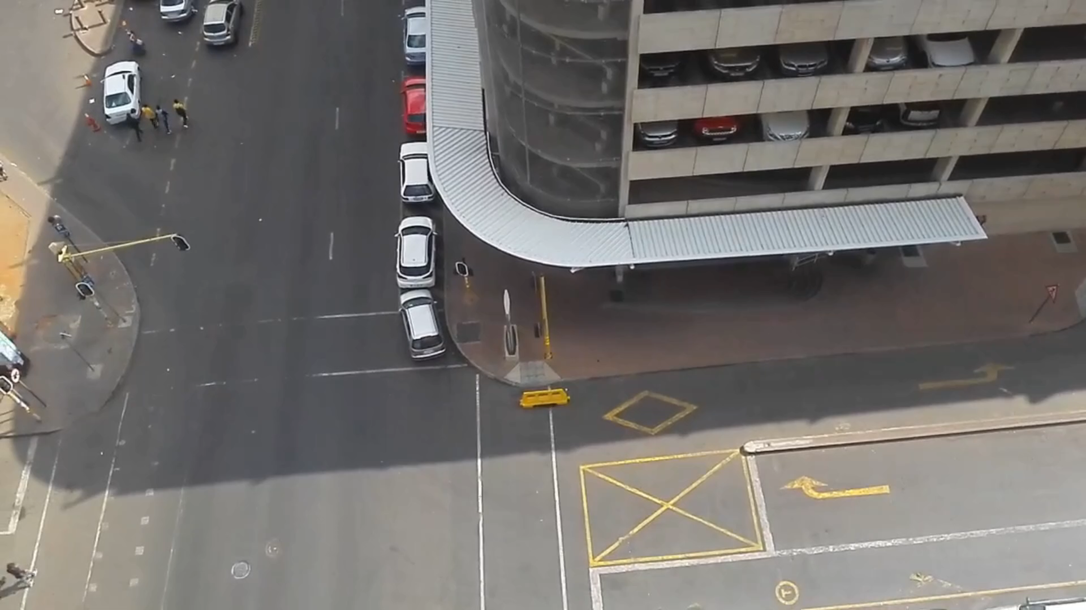
Design thinking application - Exploring solutions (Ideate and Prototype) – Prototype
AI monitoring and Drone monitoring

Slide 9
Design thinking application - Implementation and Test
Drone test:
Sound levels can be a problem
Camera angles needs further thinking
Drones are potentially vulnerable to sabotage
On-board storage should be considered
High wind speeds cause instability
Low camera resolution could make image processing challenging
Power supply and recharging means the drone will be out of service for a time
Limited field of visibility
Data connectivity issues
High windspeeds are a issue.

Slide 10
Project Review
Manager’s feedback
Broader Community is impacted by crime incidents
Drones could be loud and could annoy pedestrians
Facial recognition feature must be added and linked to a police criminal database
Incorrect criminal element profiling could do more harm than good
Impact on the organization
The solution presented will ensure police resources are used efficiently,
A monitoring back office needs to be created where humans can oversee automatically generated drone incident reports,
Full time drone pilots and armed response is required
Maintenance of drones might have a significant cost implication
Learnings
There is no easy fix to the crime problems,
Our bias and own perceptions came through in the questions

